Slide 1
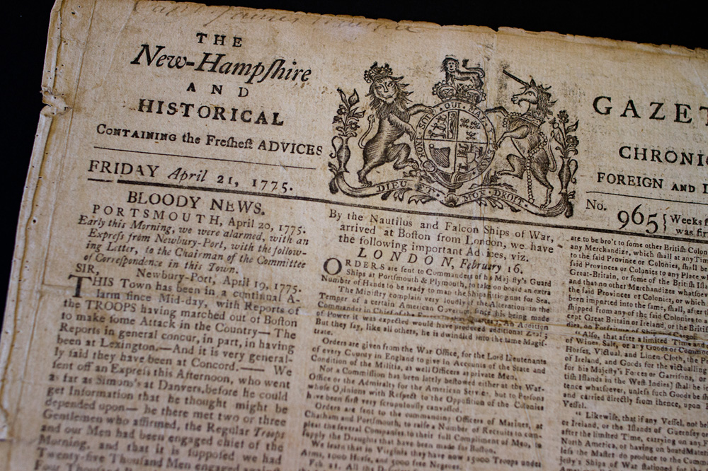
Reporting & Propaganda in the
American Revolution
Dr. Julia M Gossard, Utah State University

Slide 3
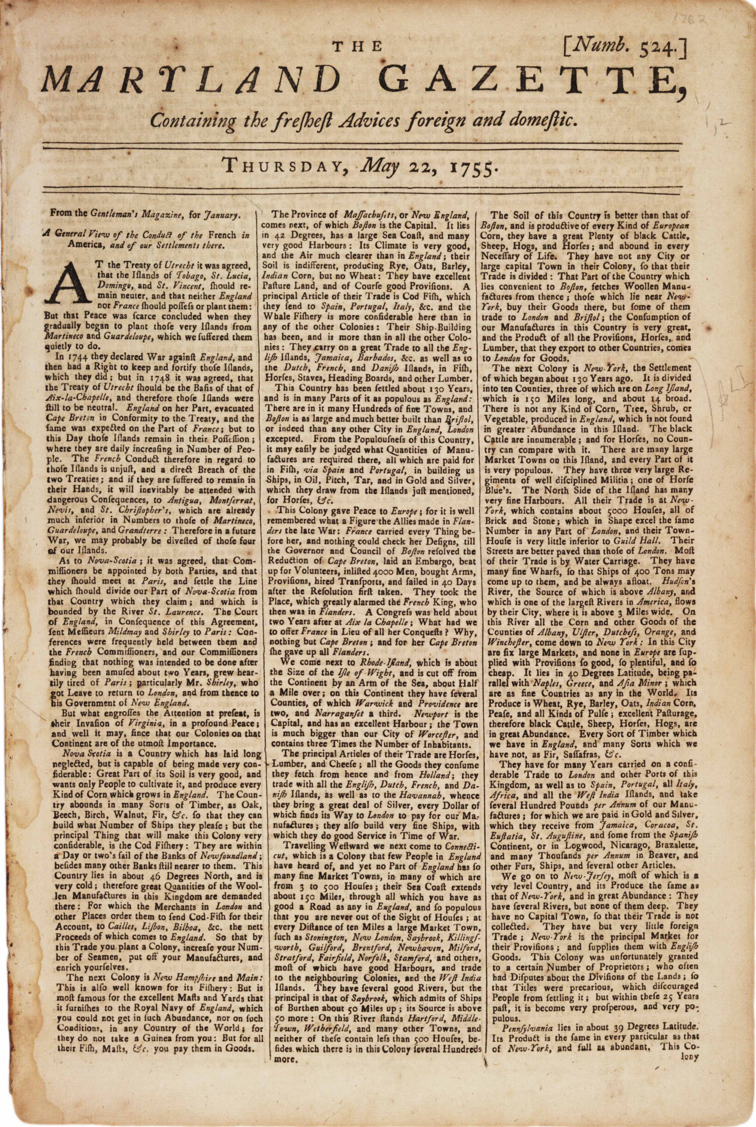
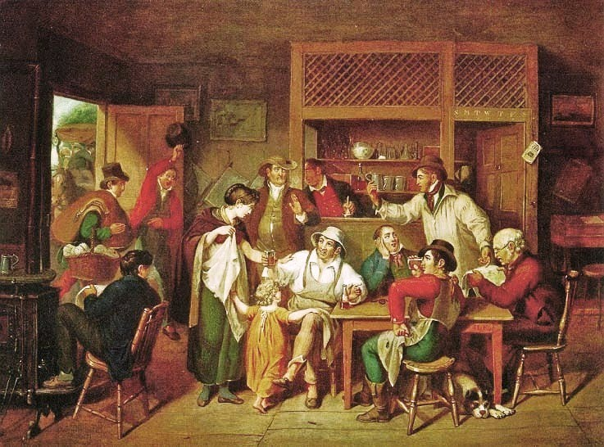
Print Culture
Books
Newspapers
Pamphlets
Political Treatises
Cartoons
1750 – 600 copies/week
1770 – 1,500 copies/week

Slide 4
Loyalist Papers
Common Propaganda Tactics
Name calling
Fear mongering
Selectivity in sources
Exaggeration
Clear agenda
Incomplete quotations
Lack of context
Sensationalism
Patriot Papers
20 in total
Boston Gazette
Essex Gazette
Pennsylvania Journal
Massachusetts Spy
New York Journal
Providence Gazette
28 in total
Boston Chronicle
Royal American Gazette
Pennsylvania Evening Post
London Chronicle

Slide 5
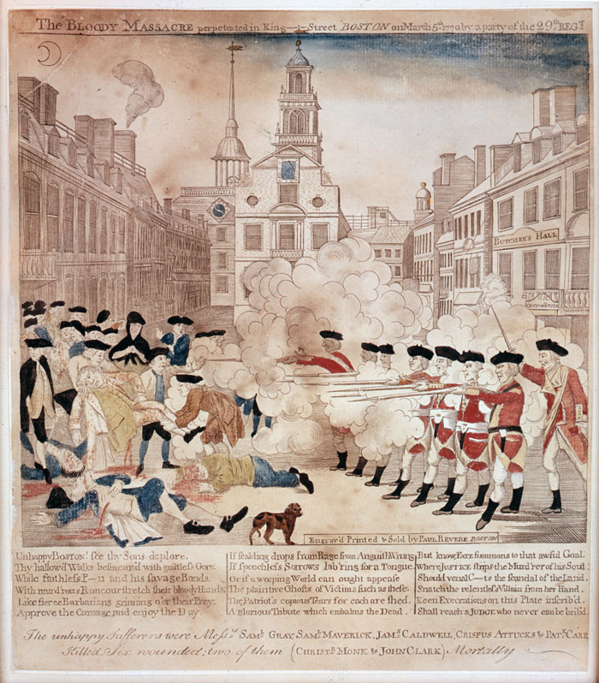
Boston Massacre
One of most sensationalized events in revolutionary period
March 5, 1770
Skirmish between Bostonians and British soldiers
British open fire into a crowd of 100-400 Bostonians, killing 3; injuring 2 who died; and severely injuring 12
Fierce fight in Loyalist and Patriot newspapers over what “really” happened

Slide 6
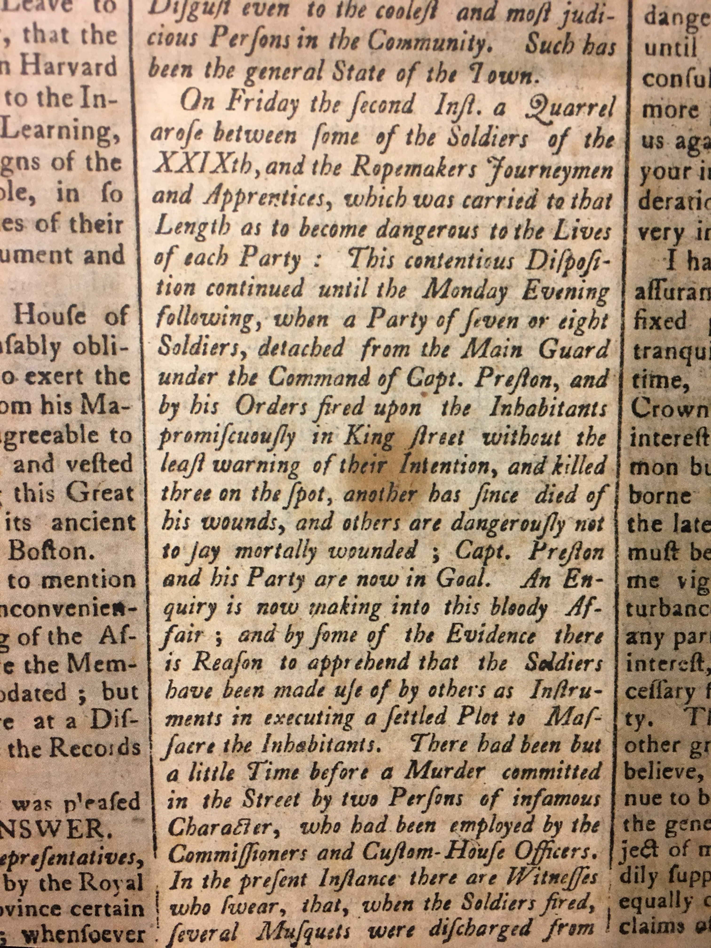
Patriot
Propaganda
Essex Gazette
“A Short Narrative of the Horrid Massacre”
March 20, 1770

Slide 7
Patriot
Propaganda
”The Bloody Massacre Perpetrated in King Street, Boston on March 5th, 1770 by a party of the 29th Regiment”

Slide 8
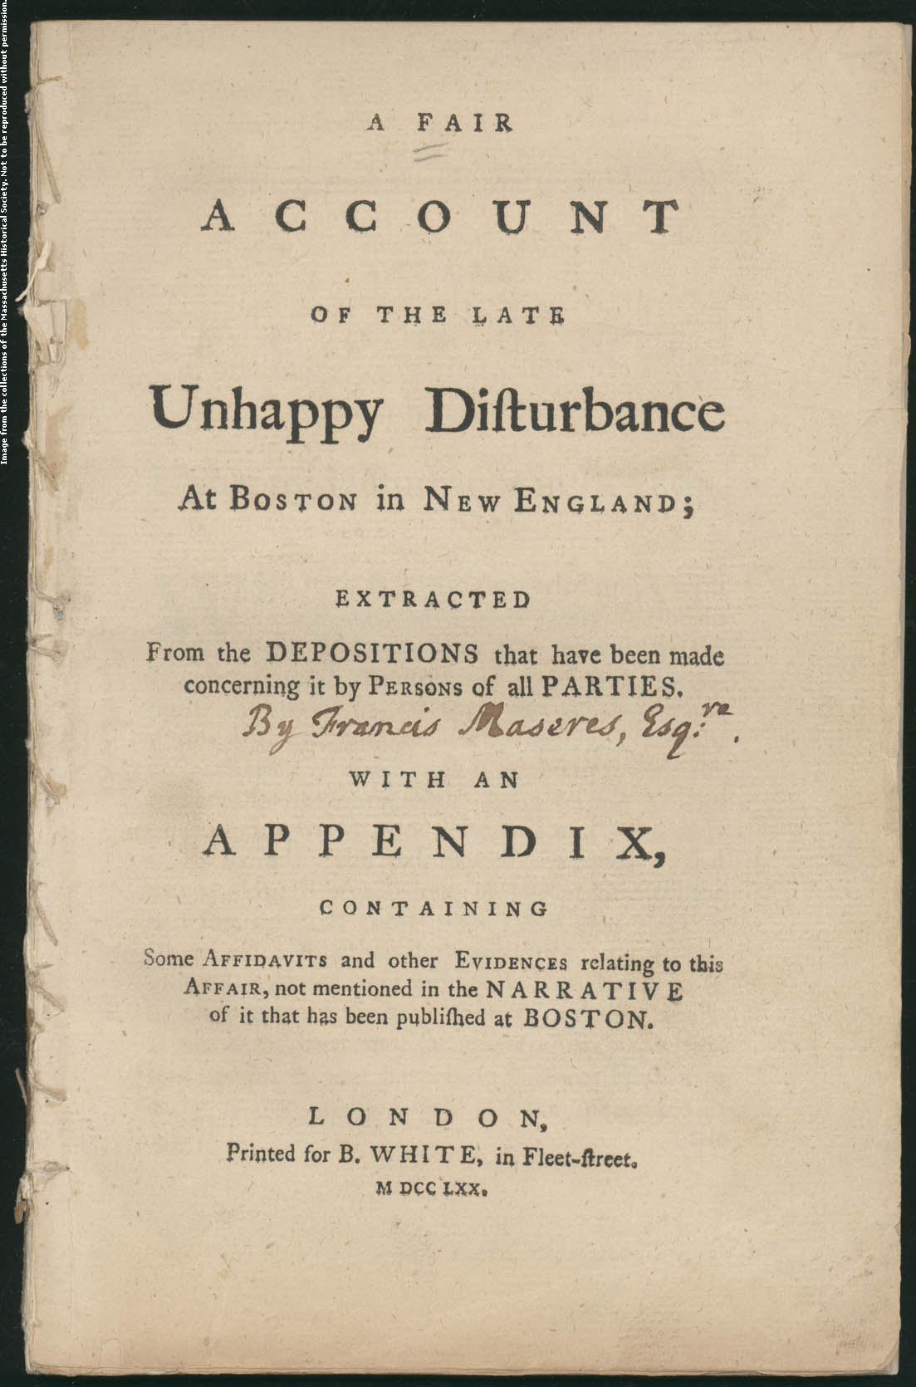
Loyalist
Propaganda
Boston Chronicle and London Chronicle
“A Fair Account of the Late, Unhappy Disturbance at Boston”
March 17, 1770

Slide 9
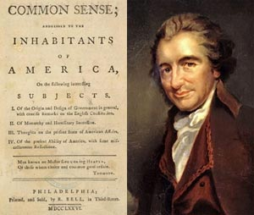
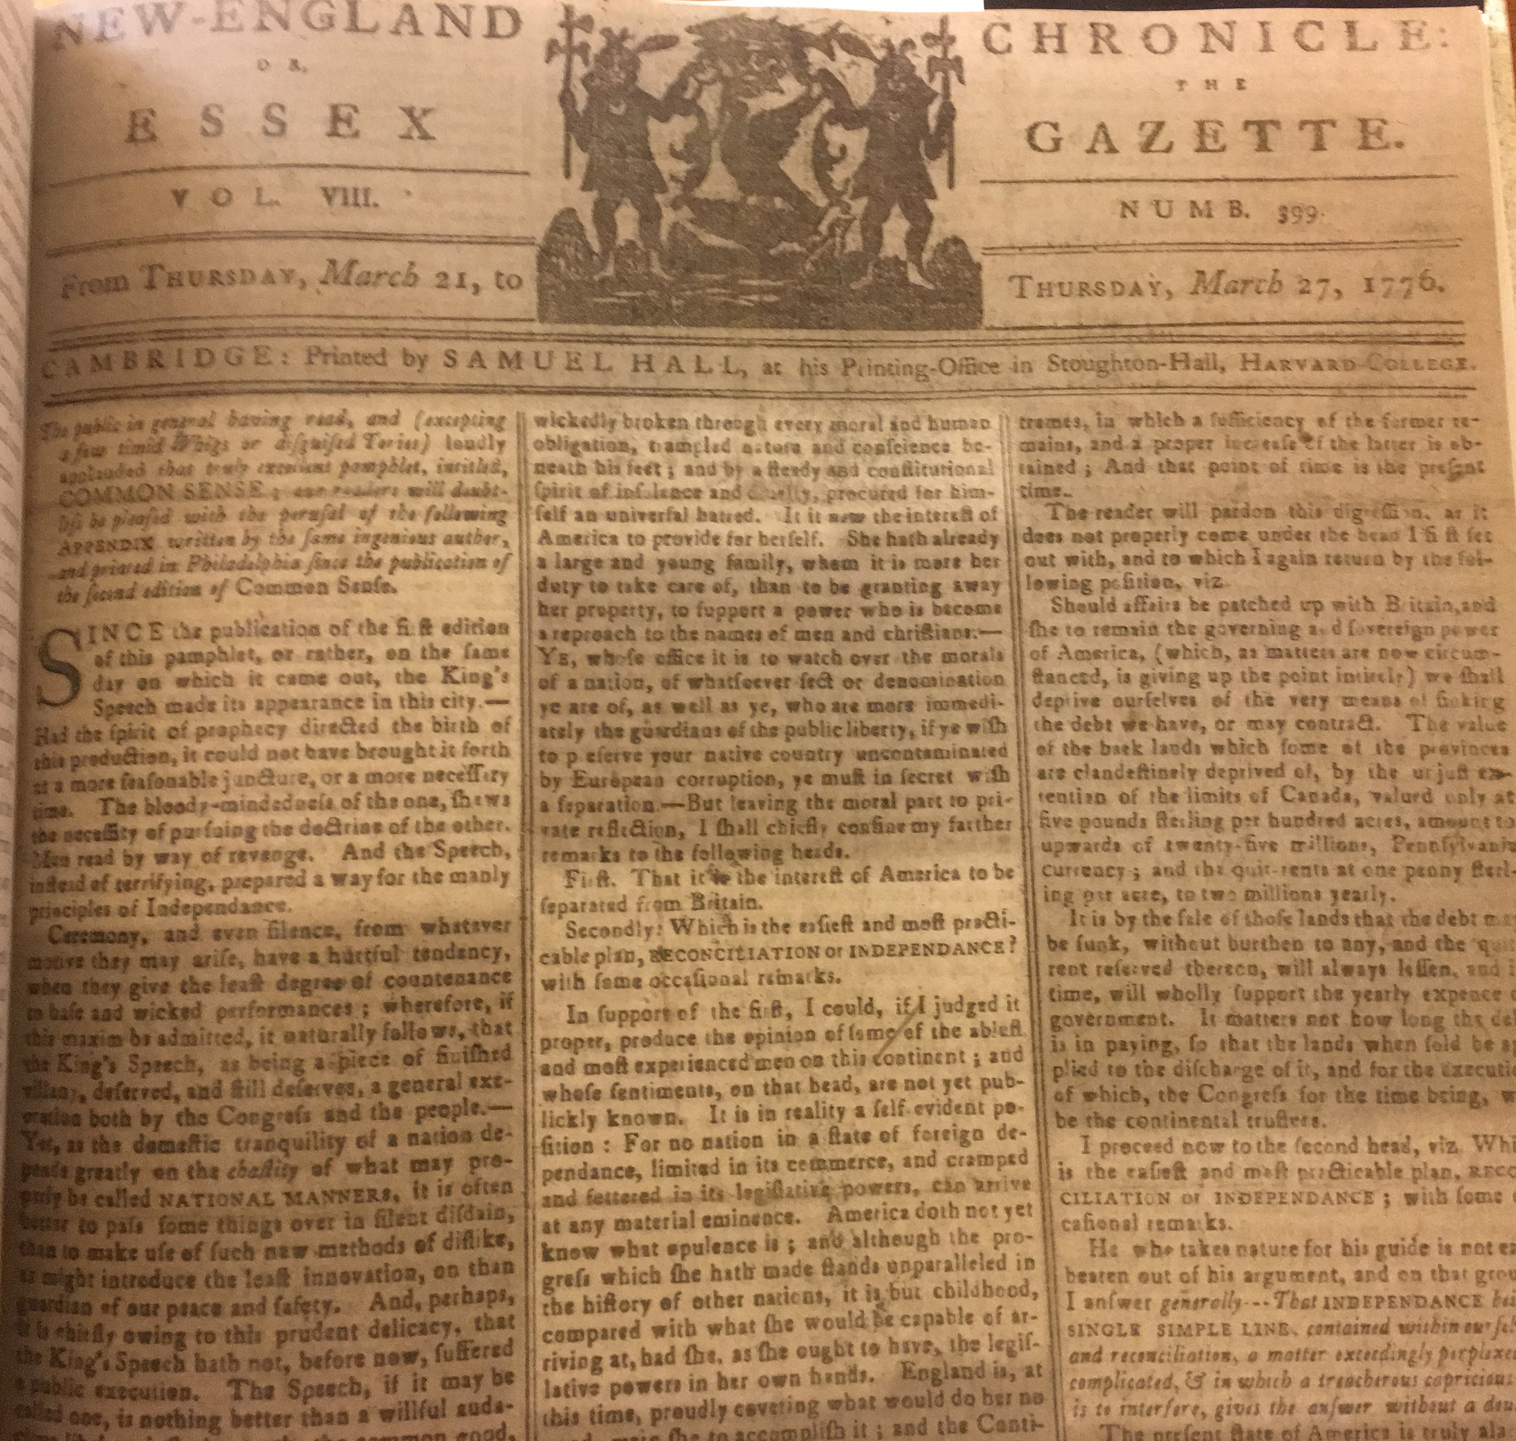
Thomas Paine
Common Sense (1776)
120,000 copies sold in 10 months
Serialized in all papers – both Loyalist and Patriot
Advocated strongly for American independence from Britain

Slide 10
